Slide 1


EURO CRISIS
FED TAPERING

Slide 2

EURO CRISIS
Why is the Euro problem getting acute? Why is Greece behaving like a spoilsport? Why is Germany persuading Greece to relent and follow austerity measures?

Slide 3
EURO CRISIS
To get a better understanding of the complex linkages of the problems in Europe, one will look at them to be part of one big family. Accordingly, Germany is the elder brother of Greece. Greece has lived beyond his means while Germany on the other hand has managed its finances prudently.

Slide 4
EURO CRISIS
So while Greece is in debt, Germany has surplus. The problem is since Germany and Greece belong to the same family; Greece’s problem is to an extent Germany’s problem. So Germany has agreed to help his brother (Greece) but in return wants Greece to mend his ways. Like any elder brother would, Germany would like Greece to change his ways, become prudent with money, undergo some years of hardships and pay his debts.

Slide 5
EURO CRISIS
Germany requests Greece to do this since Greece belongs to the same family and Germany does not want the family name tarnished.
However, the problem is that on one hand, Greece would like Germany’s help but on the other hand, may not want to follow the austerity measures. Greece feels that Germany is resorting to bullying tactics and putting his independence at stake. This is putting pressure on Germany because Germany does not want to extend help unconditionally.

Slide 6
EURO CRISIS
Since Greece and Germany belong to the same family, Germany is in a deadlock in order to preserve the family name. The problem is that if Greece defaults and decides to walk out of the family, the other brothers of Germany such as Spain, Italy, Ireland, and Portugal who too have a debt problem, might lose credibility and fall back on Germany to rescue them. Germany is afraid this could eventually lead to a split in the family.

Slide 7
EURO CRISIS
Since Germany otherwise is doing well in his business and at the same time is acting as the head of the family, the split is not something Germany wants. Also, if Greece splits from the family, people at large might lose confidence in the family name and sell off the debt that the family owes them.

Slide 8
EURO CRISIS
If this happens, one might not lend any money to the family at standard market rates. This could hurt the family business and the family business activity could come to a stand-still. This is the reason why Germany is pestering Greece to mend his ways by following fiscal discipline.

Slide 9
EURO CRISIS
Unfortunately, some Greece politicians might be misleading people to believe that there is a solution to their debt problem without having to follow some discipline either by way of austerity or restructuring of economy for better productivity. They are stirring passion among the people by stating that Germany might want to take control of their lives and is a threat to Greece’s sovereignty.

Slide 10
EURO CRISIS
Election results that are slated in June will give an indication about the future of Greece. If the Conservative Party comes to power, there is a chance that they will try to maintain fiscal discipline and keep the European Union intact. However, if the party that is opposing fiscal discipline measures comes to power, the Union might split and Greece may move out of Euro and go back to its original independent currency ‘Drachma.”

Slide 11
EURO CRISIS
Even if that were to happen, the value of Drachma could nosedive. While it would suit exports, imports would become very expensive. The debt problem may not get solved automatically. Greece might have to focus on enhancing productivity and competitiveness and may need to follow fiscal discipline. In essence, there is no short cut solution to escape debt.

Slide 12
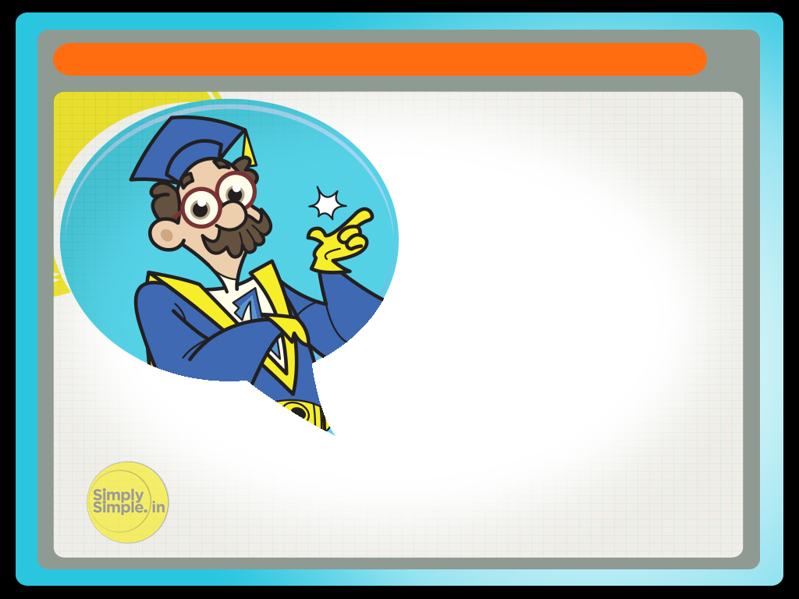
EURO CRISIS
Hope this has given you the answers to questions raised at the start.

Slide 13


Please give us your feedback at
professor@tataamc.com

Slide 14

DISCLAIMER
The views expressed in this lesson are for information purposes only and do not construe to be any investment, legal or taxation advice. The lesson is a conceptual representation and may not include several nuances that are associated and vital. The purpose of this lesson is to clarify the basics of the concept so that readers at large can relate and thereby take more interest in the product / concept. In a nutshell, Professor Simply Simple lessons should be seen from the perspective of it being a primer on financial concepts. The contents are topical in nature and held true at the time of creation of the lesson. This is not indicative of future market trends, nor is Tata Asset Management Ltd. attempting to predict the same. Reprinting any part of this material will be at your own risk. Tata Asset Management Ltd. will not be liable for the consequences of such action.
Mutual Fund investments are subject to market risks, read all scheme related documents carefully.

